Slide 1
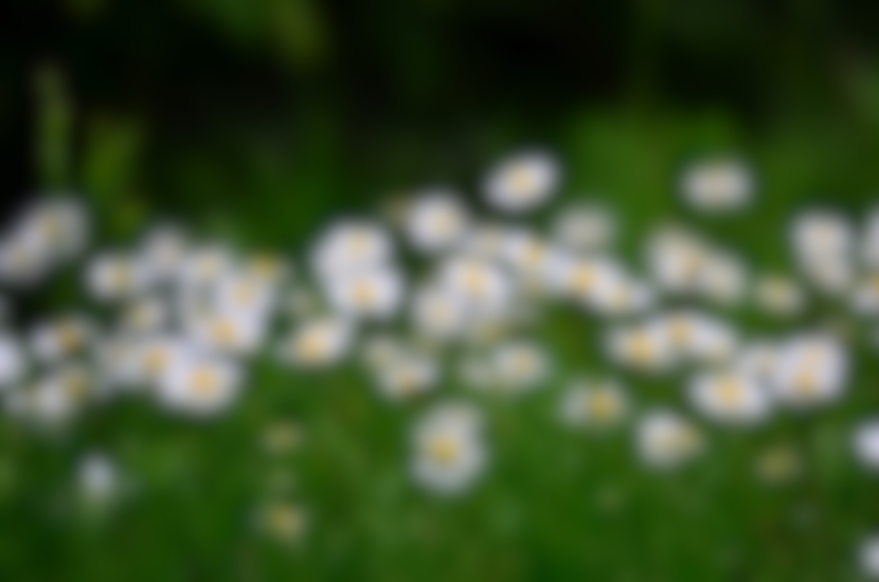
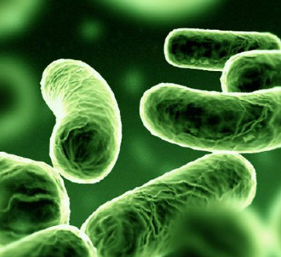
Production Of Antimicrobial Agents
USING SOME SPECIES OF BACTERIA
Supervisors
Prof. Mohamed Yacout

Slide 2



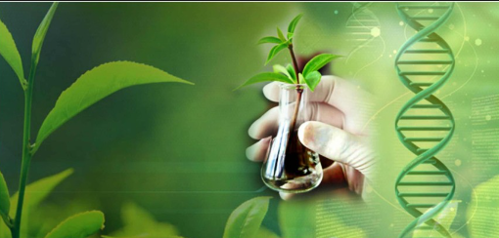

Participant Student :-
Asmaa Mabrouk Hadad
Menna Farag Mohamed
Aya Mohamed Ebrahim
Noura Saber Abdelhamed

Slide 3

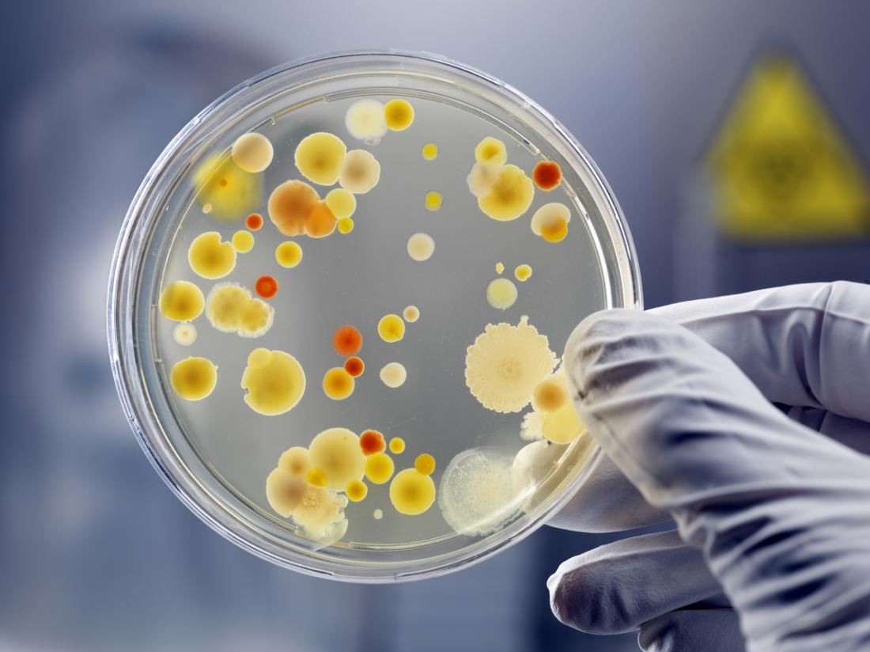

Introduction
Description of bacteria
Lactococcus sp
Cocci and gram negative
◆ Pseudomonas sp
Bacilli and gram negative

Slide 4


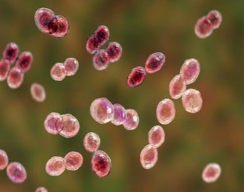
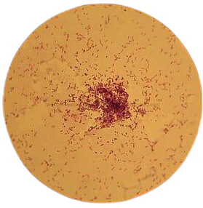
Antibiotics
Antibiotics are one of the important commercially exploited
secondary metabolites produced by fungi and In some cases,
by bacteria like at Lactococcus lactis and pseudomonas
fluorescens.
Nisin
◆ Nisin is a small gene-encoded antimicrobial protein produced by Lactococcus lactis.

Slide 5

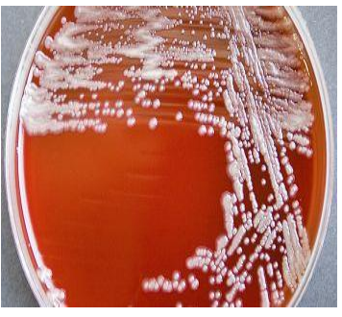
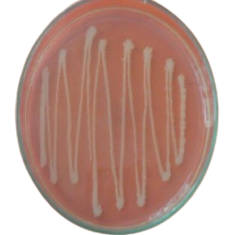

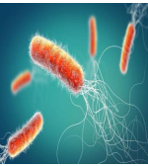

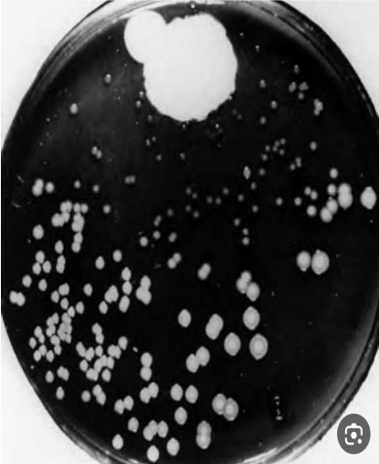
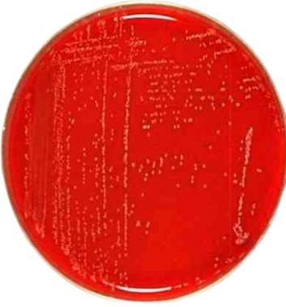
Mupirocin
◆ Produced by pseudomonas fluorescens.

Slide 6
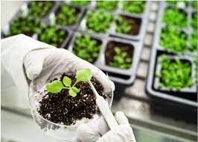

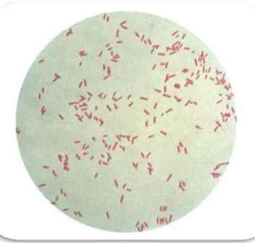


Pigment
a substance used to change the color of something .
Pyocyanin pigment
is a blue- green phenazine pigment that is produced by 90–95% of Pseudomonas aeruginosa strains.
Pseudomonas aeruginosa

Slide 7


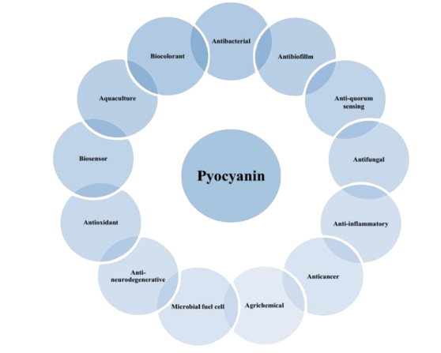

Pyocyanin has antibacterial activity against various types of bacteria and fungi.

Slide 8


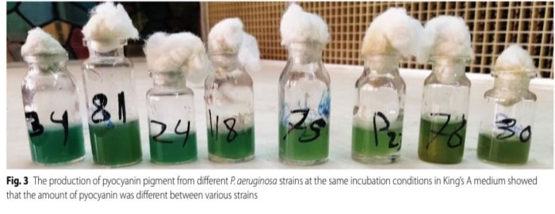
The amount of pyocyanin varies depending on the type of bacteria strain .

Slide 9

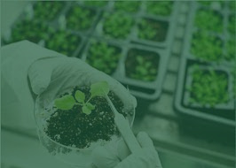
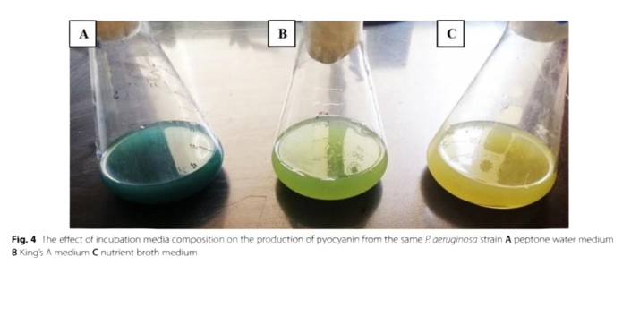
The color of pyocyanin varies depending on cultural media and different conditions.

Slide 10

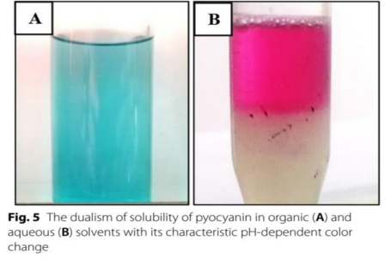
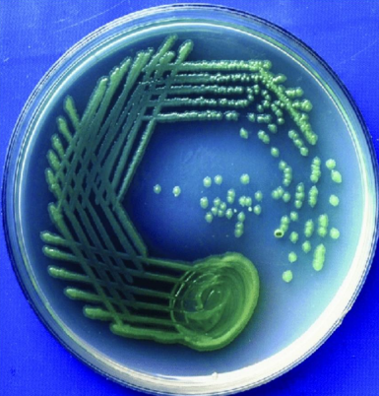

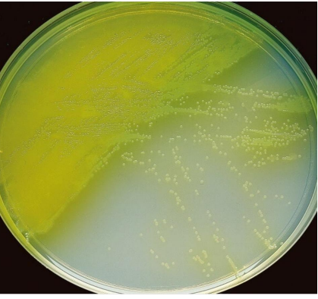
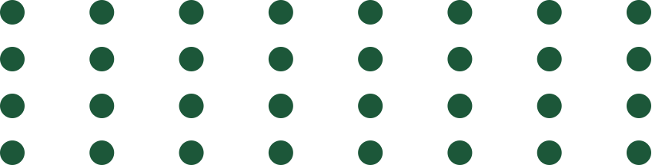
The color of pyocyanin varies depending on cultural media and different conditions.

Slide 11
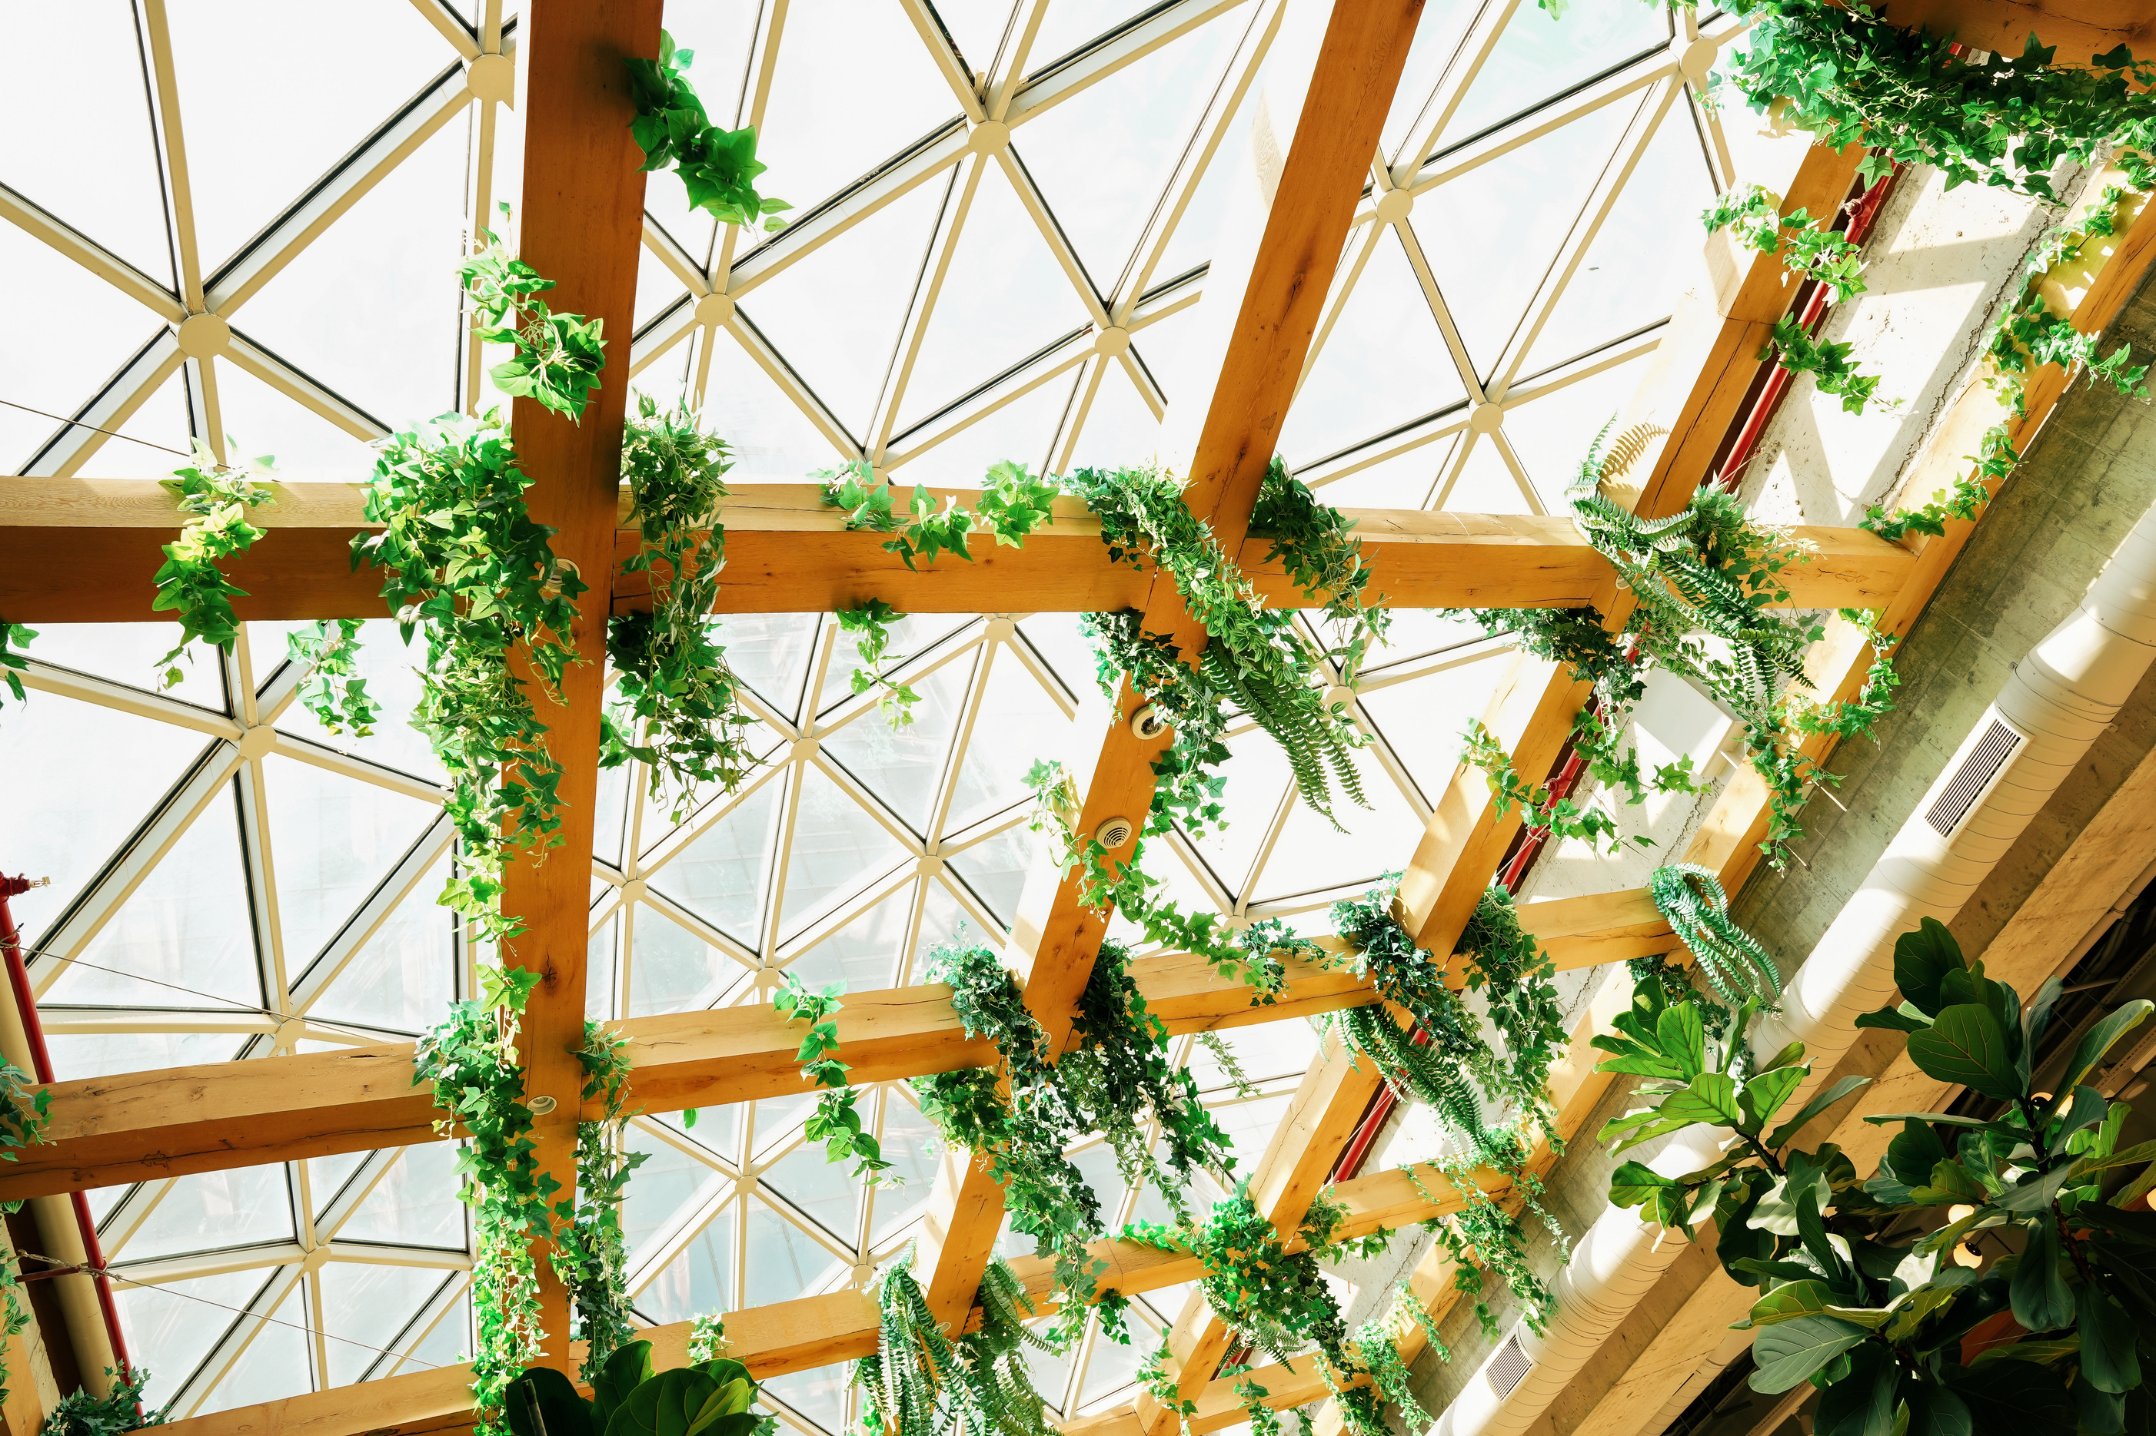


AIM OF PROJECT
production of some antimicrobial substances by two types of bacteria:
These products are:
Pigments
Antibiotics
Lactococcus sp
Pseudomonas sp

Slide 12


Materials and methods
Product:
Nisin,Mupirocin,Pyocyanin
Bacteria:
Lactococcus lactis
Pseudomonas aeruginosa
Pseudomonas fluorescens
Media :
MRS ,GSNB , Nutrient broth

Slide 13

DNA Extraction will be performed twice,
First (Control)
before starting the work steps
Second transactions
after completing the various
PCR and Gel electrophoresis will be done in both cases to compare them

Slide 14
References
Anna Drabik, Anna Bodzon-kulakowska 2013 in Proteomic Profiling and Analytical chemistry
Chandra Mouli Lalam et al 2015 Published by Academic Open Access LTD, 2015
Kufrin G (2008) Finding the optimum composition of nutrient medium needed for the growth of Pseudomonas fluorescens and for the biosynthesis of mupirocin. Dissertation, University of Zagreb
Merri Lynn Casem BA, PhD(2016) in Case Studies in Cell Biology
Narsing Rao MP 2017, Xiao M, Wen-Jun LI. Fungal and bacterial pigments:
secondary metabolites with wide applications. Front Microbial.; 8:1113.
Numan M, et al 2018. Therapeutic applications of bacterial pigments: a
review of current status and future opportunities. 3 Biotech.; 8:1–15.

Slide 15
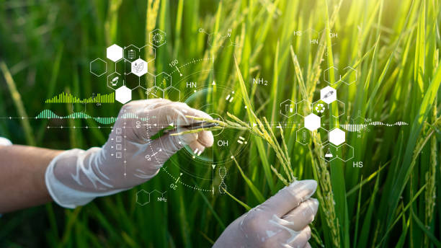
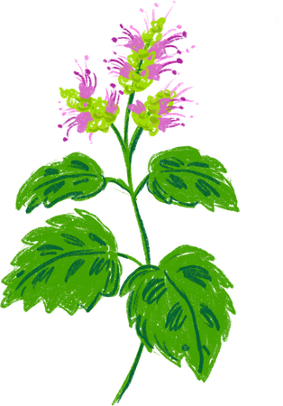
THANK YOU

